Slide 1
ChatOps with PowerShell
Just make a bot do it.
Matthew Hodgkins - @matthodge

Slide 2

Why does this happen?

Slide 3


Slide 4
Agenda
What is ChatOps?
Bots
Deploying a bot
Code examples and demos
Security

Slide 5
Why does this happen?

Slide 6
Why does this happen?
Distribution is hard
The command prompt is forgotten
Permissions

Slide 7
ChatOps

Slide 8
What is ChatOps?
Bringing tools into chat
Making work more visible
Communication and automation in the same place

Slide 9
What tools could I bring into chat?
Restart services
Add users to Active Directory
Create tickets
Start deployments
Pull event logs

Slide 10
What are the benefits?
Friendly wrapper around automation
Transparency
Onboarding people

Slide 11
How does it benefit you?

Slide 12
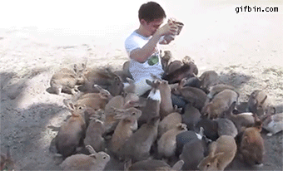
How does it benefit you?

Slide 13
Bots

Slide 14
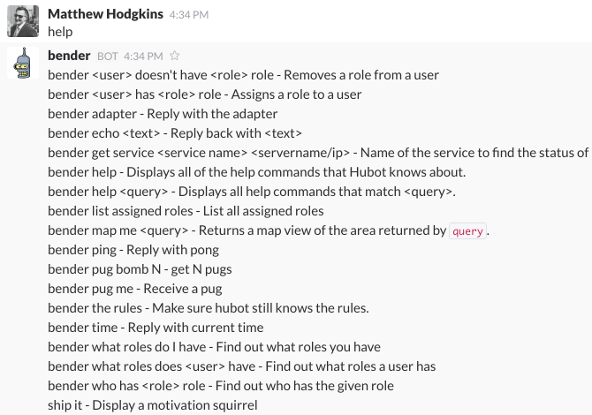
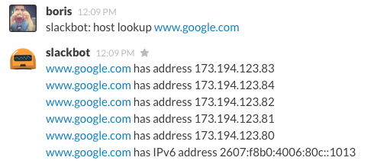
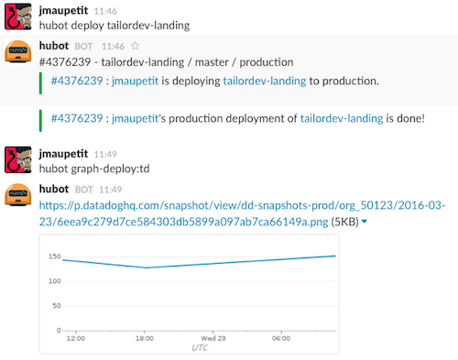
The Bot Experience

Slide 15




Errbot + Slack + PowerShell

Slide 16
# Full code from demo at: github.com/MattHodge/WindowsErrbot
# # # # # # # # # # # #
# Install Requirements
# # # # # # # # # # # #
# Use Chocolatey to install python & git
choco install python -y
choco install git.install -y
# # # # # # # # # # # #
# Install Python Packages
# # # # # # # # # # # #
# Upgrade python package manager
python -m pip install --upgrade pip
# Install python packages (requirements file from git repo)
python -m pip install -r ./requirements.txt

Slide 17
Demo 1
Bring Errbot Online

Slide 18
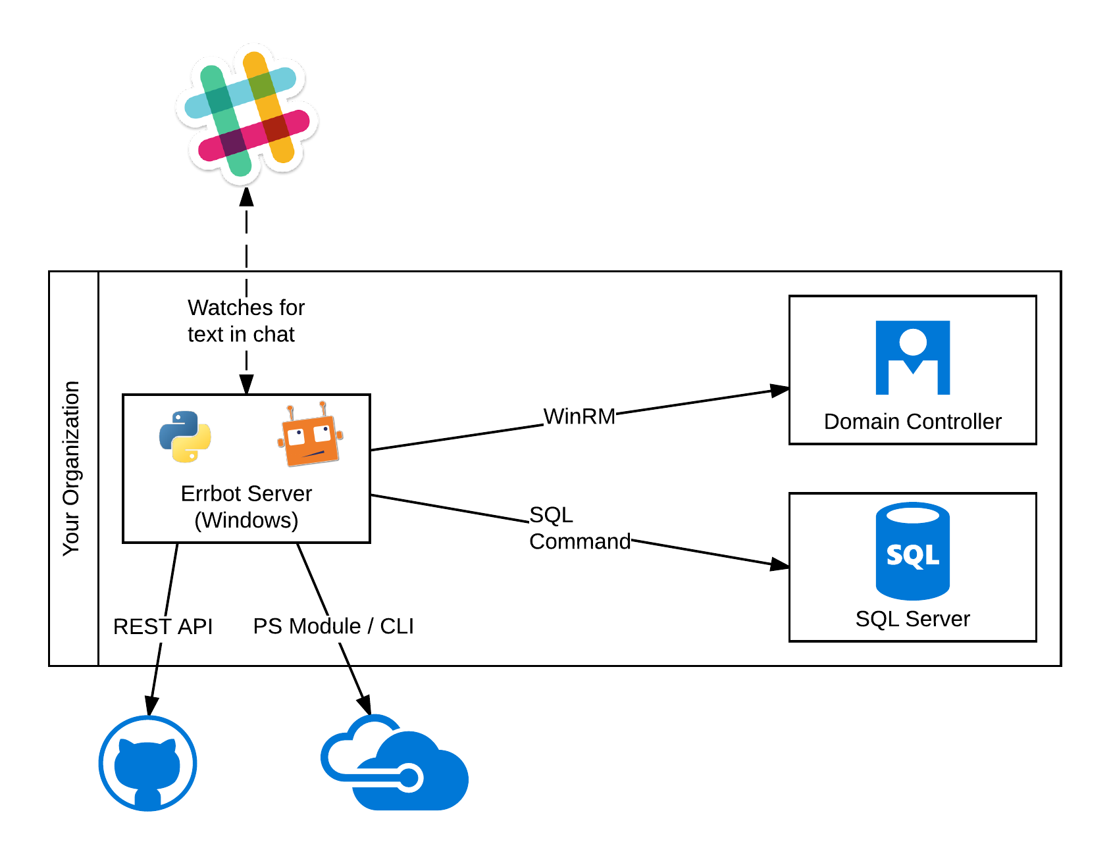

Slide 19
Demo 2
Errbot Folder Structure & Hello World

Slide 20
Making it look pretty
*bold*
> Block quote
`emphasis`
```
Code
Block
```

Slide 21
Demo 3
Slack formatting

Slide 22
Now let's bring in PowerShell
By calling powershell.exe -command &{ xx }
Capturing the result
Sending it to Slack

Slide 23
Demo 4
PowerShell Time :D

Slide 24
PowerShell Remoting
Use PS remoting like normal
Pywinrm (cross platform)

Slide 25
Demo 5
Pywirnm

Slide 26
Security
Don’t store your passwords in code!
Audit logs
Be selective with access to commands

Slide 27
Demo 6
Security

Slide 28
Wrap Up
ChatOps
Bots
Deploying a bot
Basics of Errbot
Integrating PowerShell
Security

Slide 29
Your action plan
Clone the demo code: https://github.com/MattHodge/WindowsErrbot
Run install_errbot.ps1
Add your slack token as env variable
Run start_errbot.ps1
Start running your PS functions from chat!

Slide 30
Why does this happen?

Slide 31
Questions?
Matthew Hodgkins
Twitter: @matthodge
Blog: https://hodgkins.io
Coolblue - careersatcoolblue.com

